Slide 1
ML讀書會報告
報 告 者：李尚霖

Slide 2
outline
Why Gradient Descent
Algorithms
Gradient Descent Tips
Experiment
Warm Up
To Learn More

Slide 3
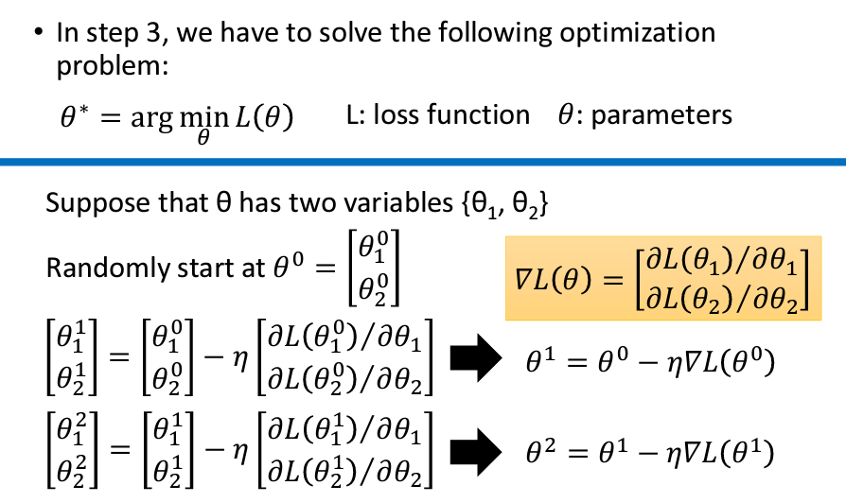
1.Why Gradient Descent

Slide 4
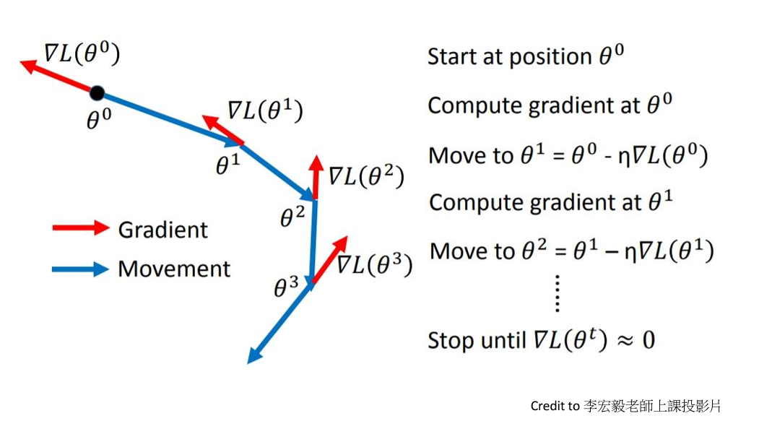
2.Algorithms—SGD

Slide 5
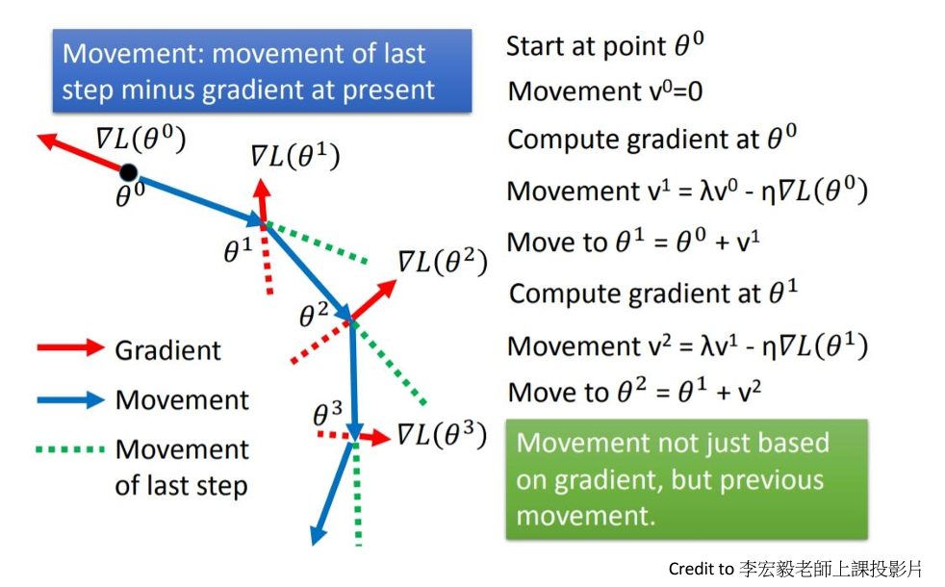
2.Algorithms—SGDM

Slide 6
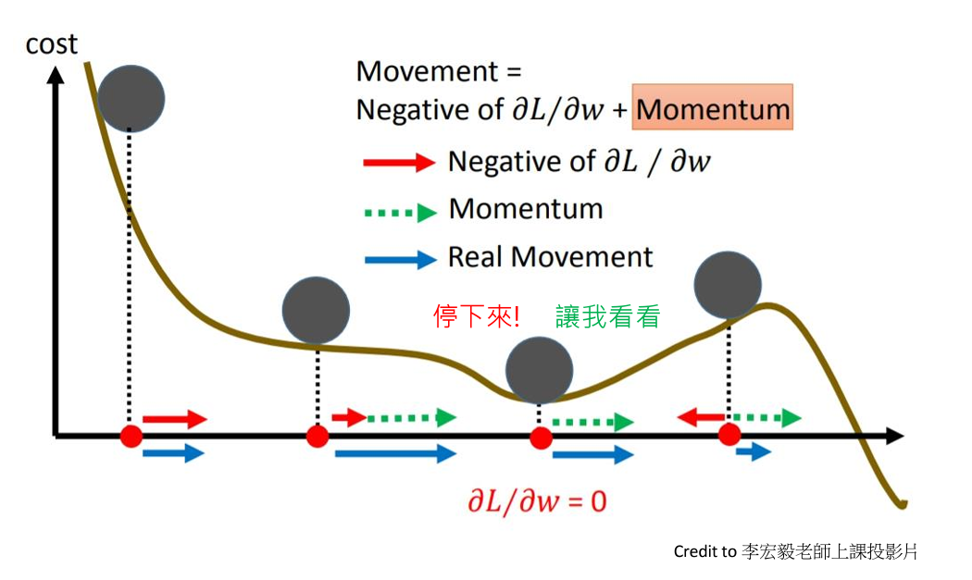
2.Algorithms—Why momentum

Slide 7
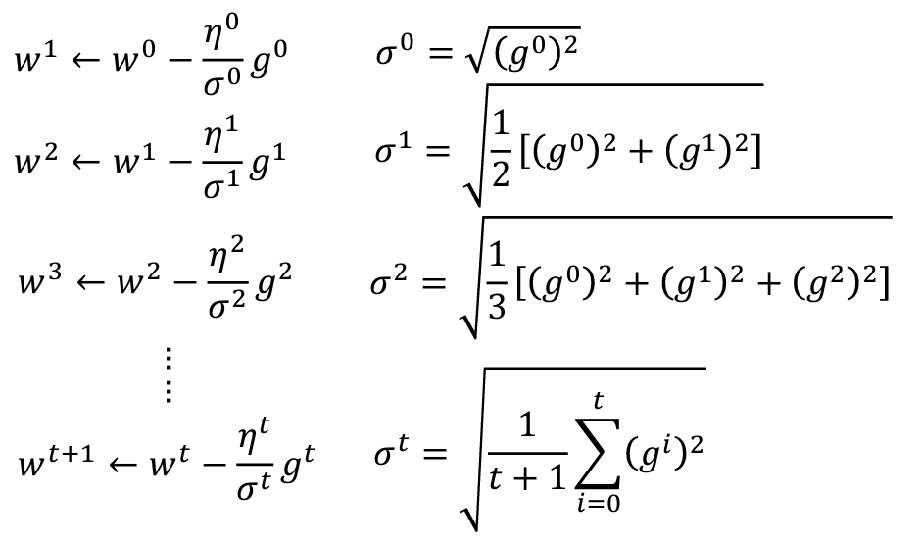
2.Algorithms—Adagrad

Slide 8
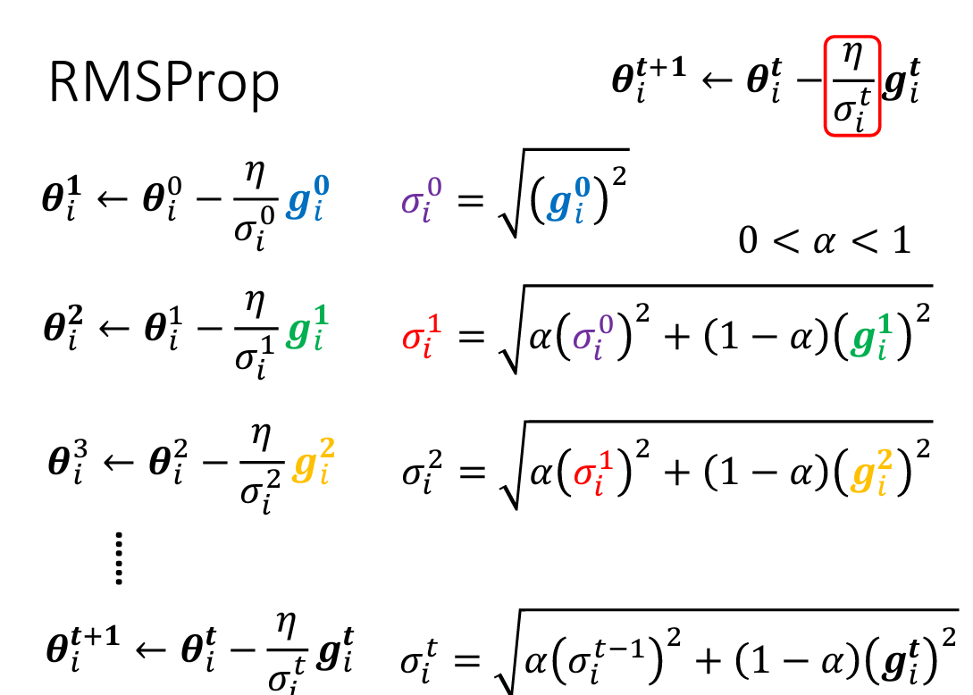
2.Algorithms—RMSprop

Slide 9
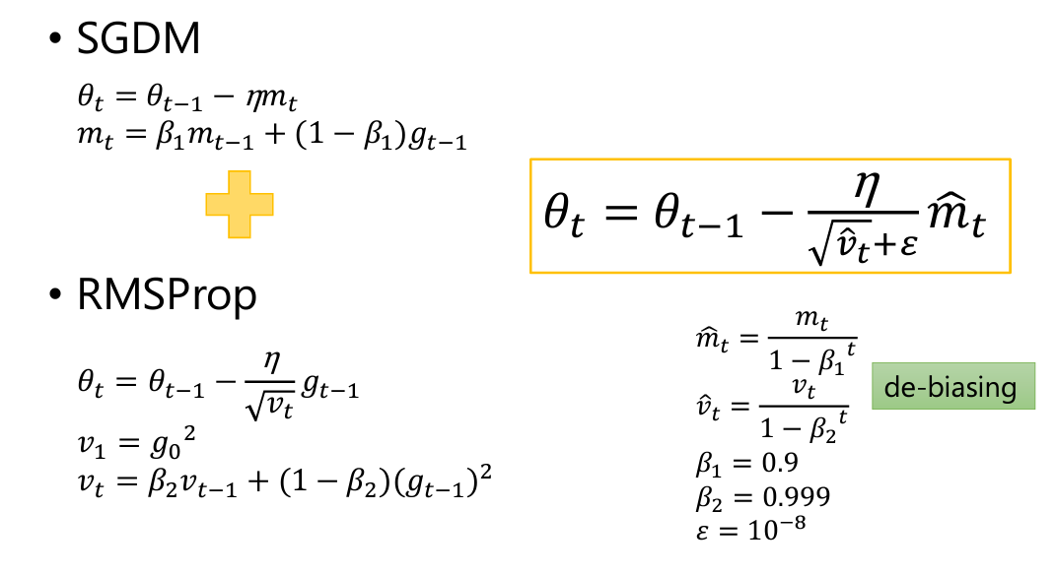
2.Algorithms—Adam

Slide 10
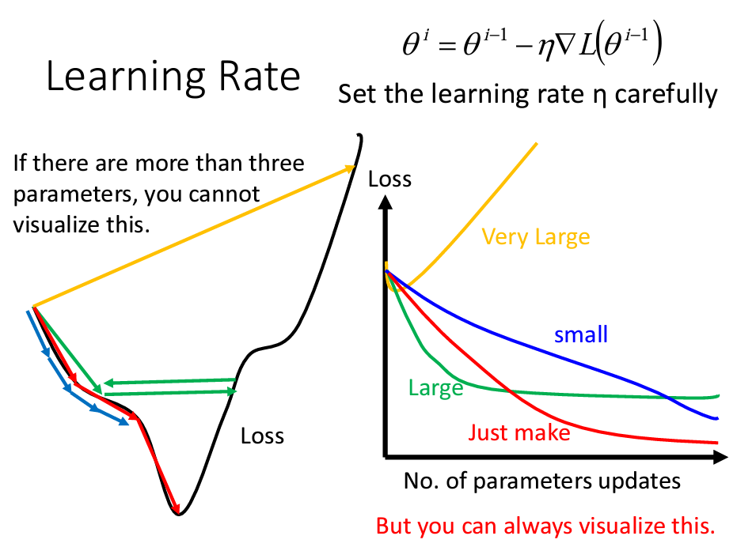
3.Gradient Descent Tips

Slide 11
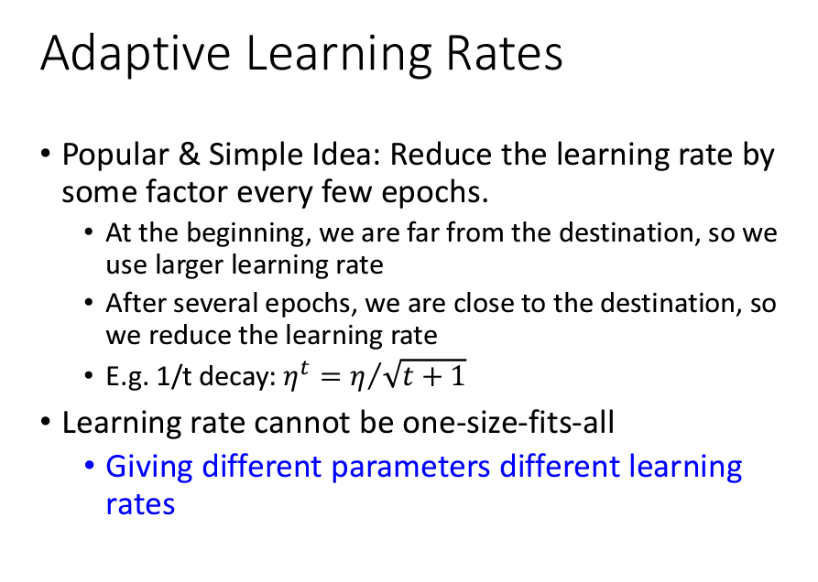
3.Gradient Descent Tips

Slide 12
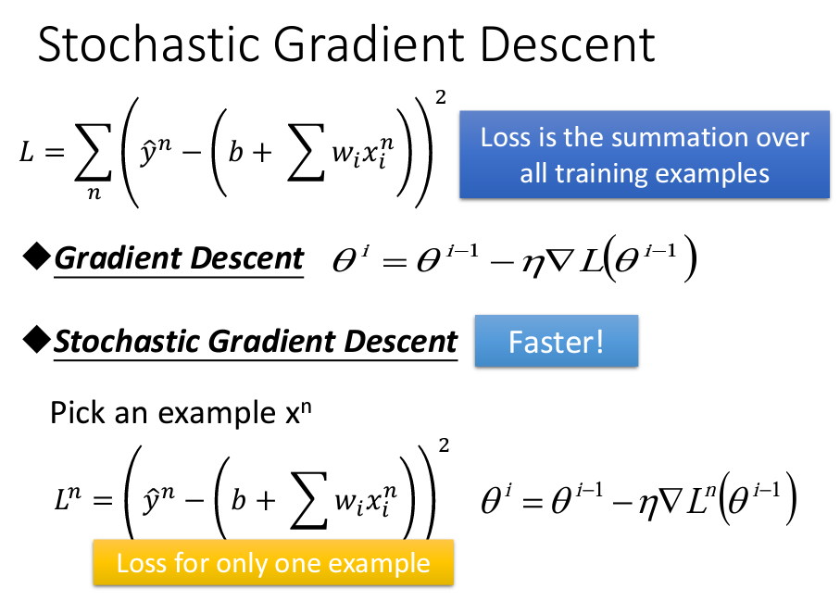
3.Gradient Descent Tips

Slide 13
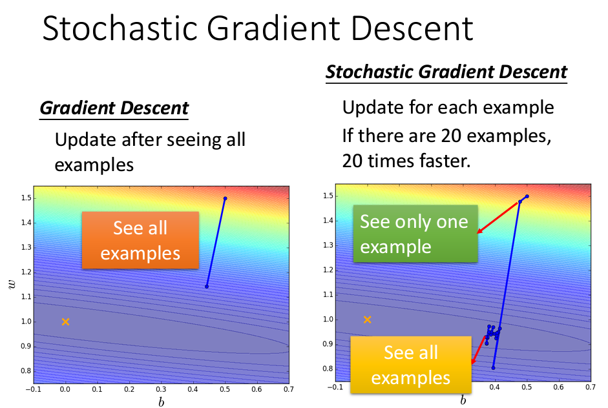
3.Gradient Descent Tips

Slide 14
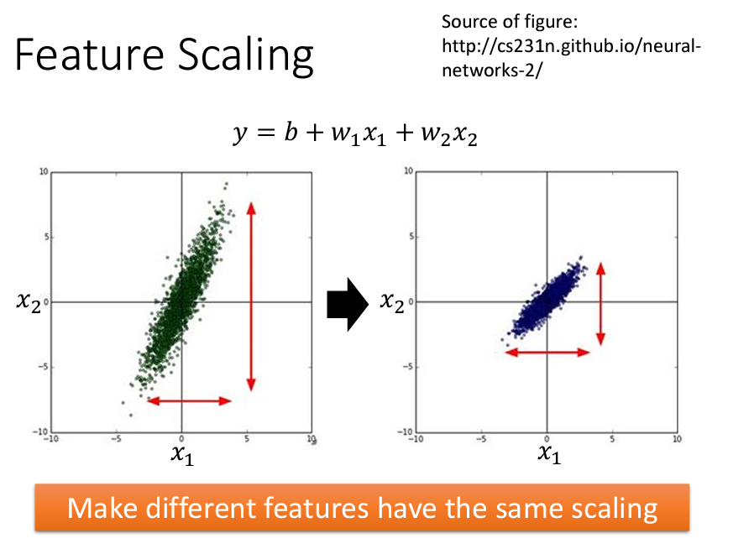
3.Gradient Descent Tips

Slide 15
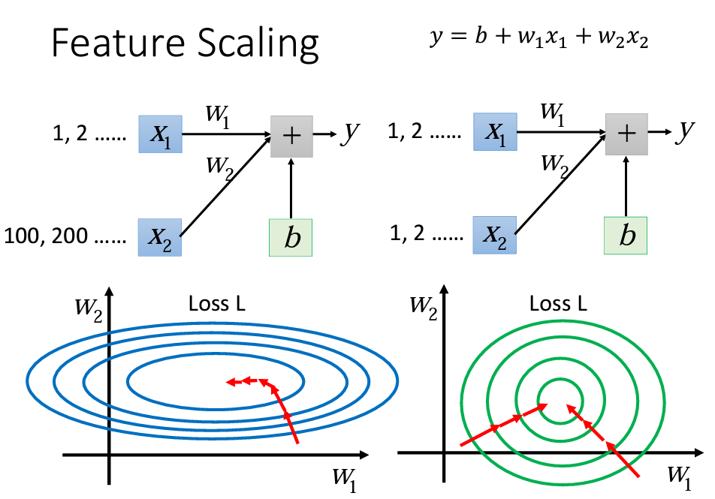
3.Gradient Descent Tips

Slide 16
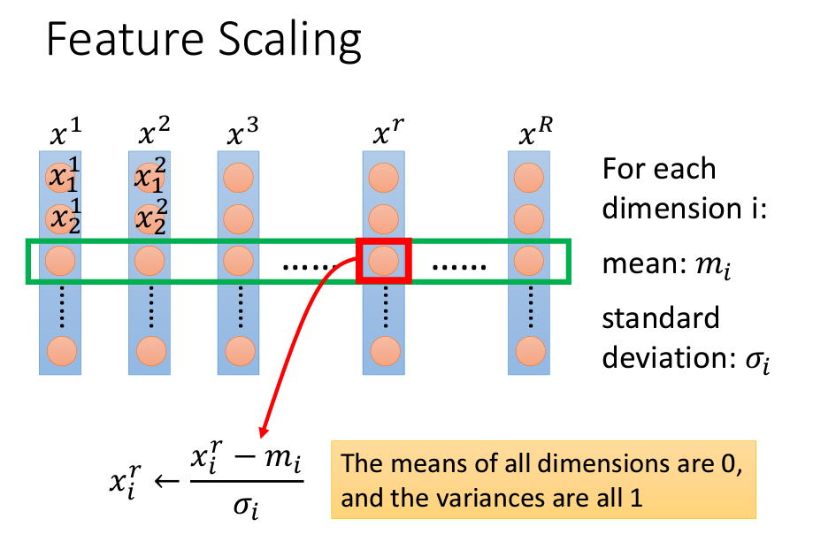
3.Gradient Descent Tips

Slide 17
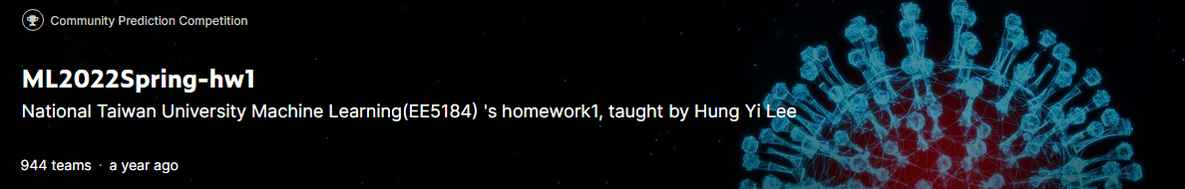
4.Experiment

Slide 18
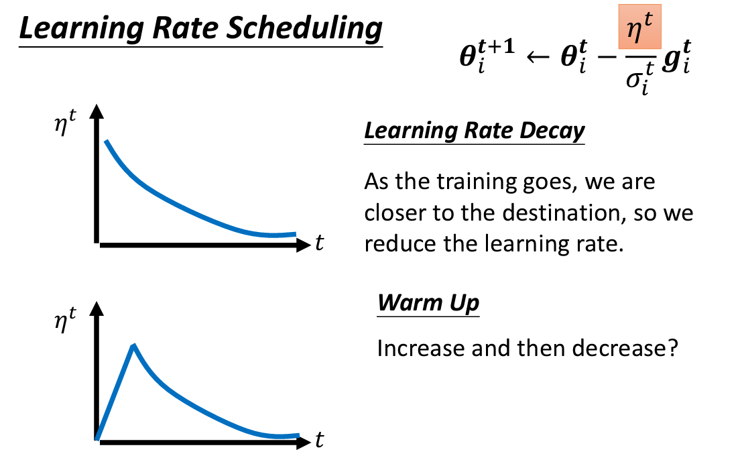
5.Warm Up

Slide 19
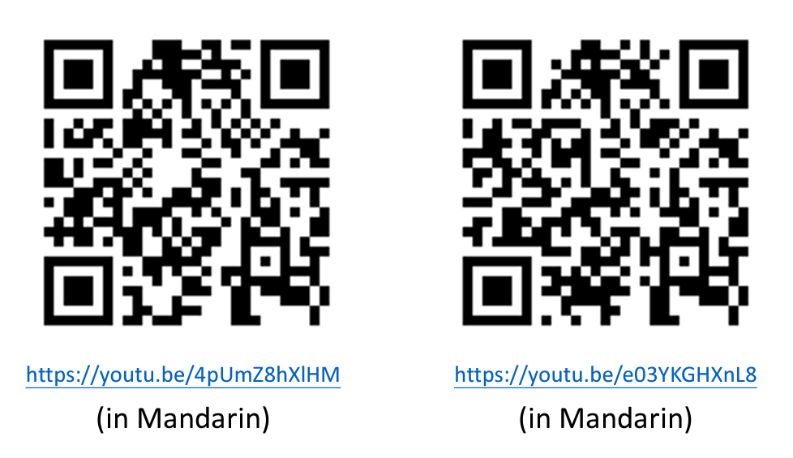
6.To Learn More

